Slide 1

Welcome
A Presentation on
Attendance Monitoring System by Face Recognition using Deep Learning Technology and Computer Vision
Semester: Spring 2021-22
Notes:
Hello, everyone! I am S. M. Iramul Murshed. I'll begin the presentation on behalf of our group. The topic of our presentation is "Attendance Monitoring System by Face Recognition using Deep Learning Technology and Computer Vision."

Slide 2
Supervised by
Dr. Debojyoti Karmaker
Assistant Professor
Department of Computer Science
American International University-Bangladesh
Group Members
IHSAN MD. AL AQIB 18-37074-1
MD. SAKIBUL ALAM UTCHAS 18-37079-1
S.M. IRAMUL MURSHED 18-37069-1
HASEBUL HASAN SHIHAB 18-37031-1
Notes:
Here is the list of our group mates and the honourable faculty who supervised us.

Slide 3

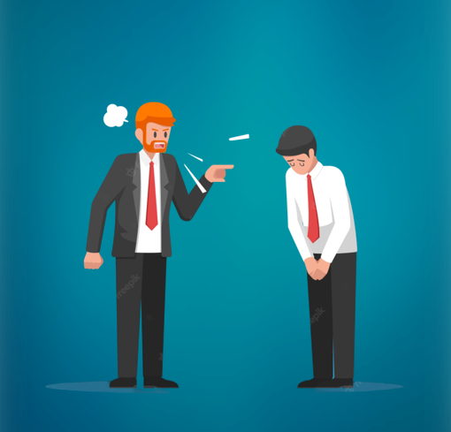

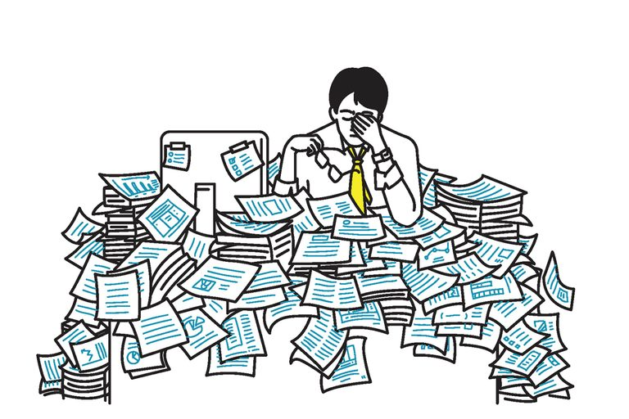
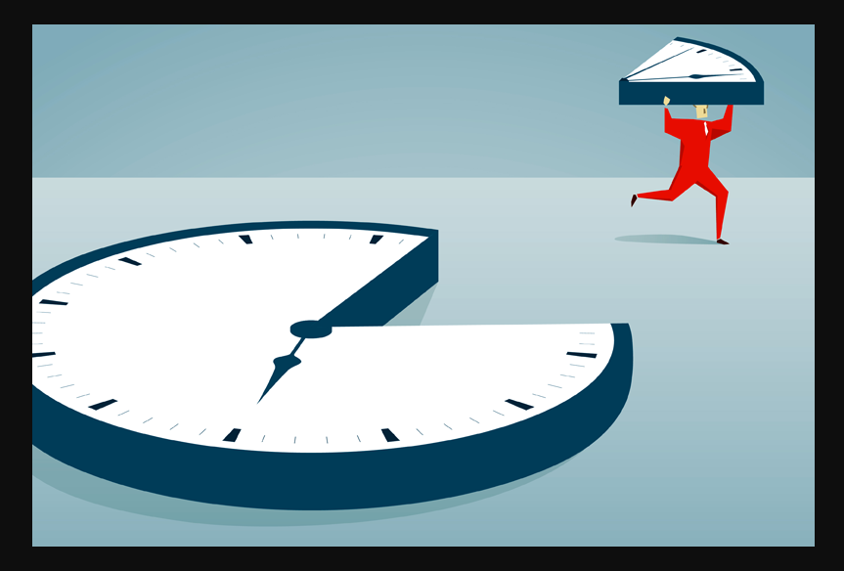

related work
model
introduction
future work
limitations
result
cnn layers
Notes:
Before we start, the most important question is: why should we use it? Well, we live in a modern era where every second is important. The traditional attendance system is backdated and has lots of drawbacks. For starters, it steals time. Usually, a class contains 45 minutes. For this amount of session, traditional attendance consumes a large portion of time.
Next Slide Secondly, it increases stress on the respective faculties by asking them to do extra paperwork by taking attendance.
Next Slide Thirdly, there could be more than one person with the same name in the class, and proxy attendance can be done without actually attending the class.
Next Slide Fourthly, it is common for students and teachers to misunderstand each other due to human error.
Next Slide And finally, there may be a lot of weird stuff that can happen in the classroom, making it difficult to take attendance.
Next Slide

Slide 4
related work
model
introduction
future work
limitations
result
cnn layers
Group Members
MD. MUZAKKER HOSSAIN 18-37801-2
ZAHIN AWOSAF 18-37064-1
MD. SALMAN HOSSAN PROTTOY 18-36902-1
ABU SALEH MUHAMMOD ALVY 18-37487-1
Notes:
To deal with these problems, we came up with a solution that overcomes the shortcomings of the traditional attendance system.

Slide 5
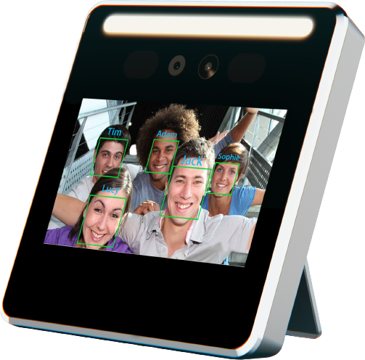
related work
model
introduction
future work
limitations
result
cnn layers
Notes:
Our thesis title suggests that ours is an attendance monitoring system. In our work, we built a model that detects and recognizes person from dataset. In this research, we used transfer learning to recognize faces.
In the future, we plan to create a model that can recognize everyone in the office or institutions and register their information into a database simultaneously.

Slide 6
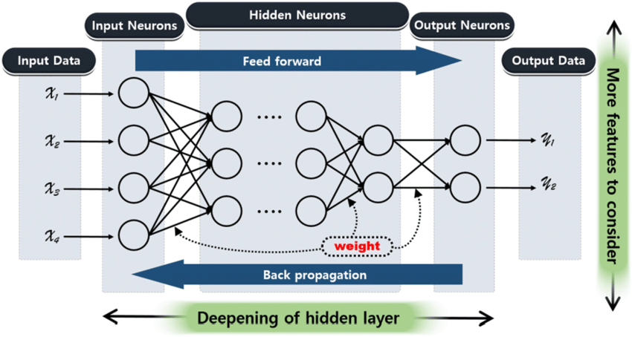
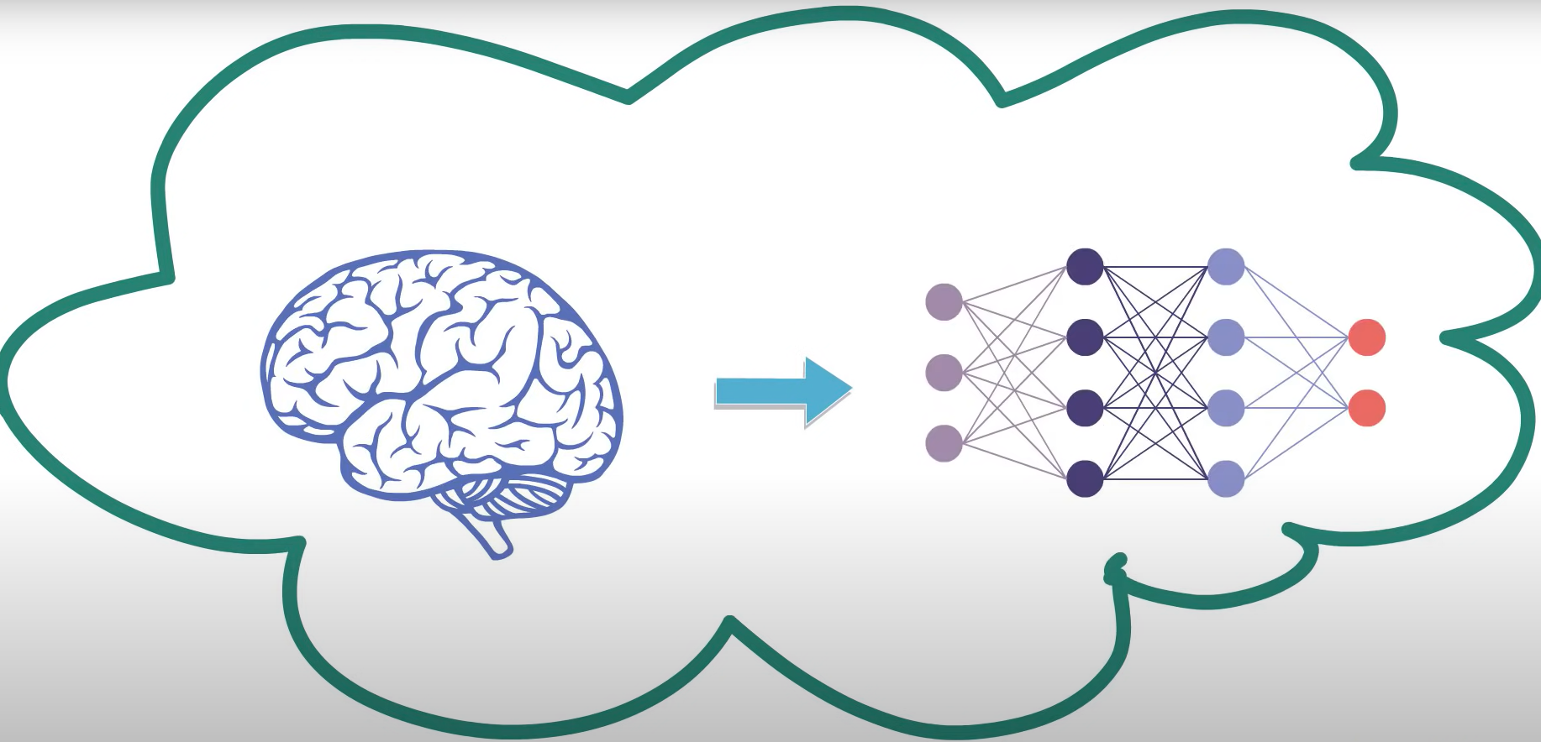
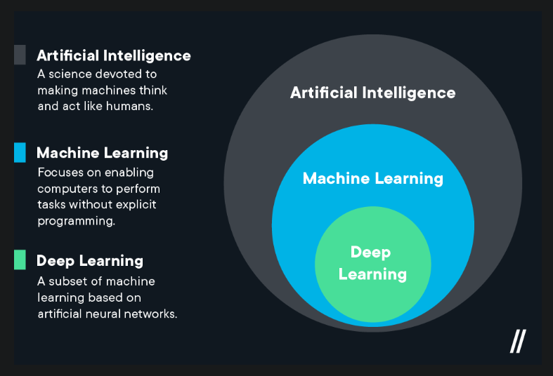
related work
model
introduction
future work
limitations
result
cnn layers
Notes:
Deep learning
Typically, we never wonder how Google translates an entire website into a different language within a second, or a phone gallery that groups images based on their location. All of these are products of deep learning
But what exactly is deep learning? Deep learning is a subset of machine learning, Machine learning is a subset of artificial intelligence.
Next Slide Deep learning is a type of machine learning inspired by the structure of the human brain. It is a machine learning technique that learns features and tasks directly from data.
Next Slide Deep learning is all about neural networks. Neurons are the core entity of neural network is where the information processing takes place. Each of the pixels is fed to the neuron in the first layer of the neural network which is called input layer. On the other hand, there is an output layer with each neurons representing output with the hidden layer existing between them. That is from my end, my other groupmates will discuss the rest.

Slide 7
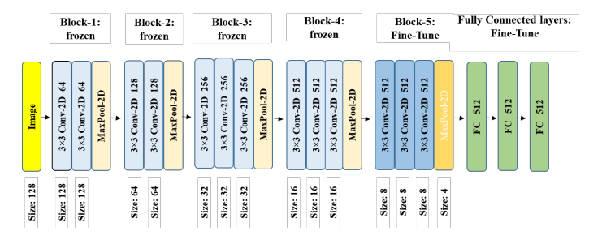
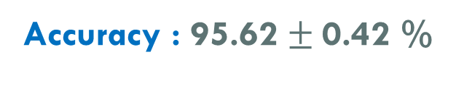
Using Siamese Networks with Transfer Learning for Face Recognition on Small-Samples Datasets
Model : Siamese-VGG
Dataset Used : LFW dataset
model
Contains over 13000 facial images of 1680 individuals.
Coloured images with image size 250 X 250.
related work
future work
introduction
limitations
result
cnn layers
Group Members
MD. MUZAKKER HOSSAIN 18-37801-2
ZAHIN AWOSAF 18-37064-1
MD. SALMAN HOSSAN PROTTOY 18-36902-1
ABU SALEH MUHAMMOD ALVY 18-37487-1
Accuracy : 95.62 $±$0.42 %
Fig. : VGG-16 with fully connected layers on top for fine-tuning.
Notes:
in related work, We discuss models models, those are
Siamese-VGG
MicroFace (VGG-16 Based)
CNN
Transfer learning was used in this work. To extract features in siamese architecture and fine-tune it, a pre-trained VGG-16 CNN model was utilized. In fine tuning part, all the fully connected layers of VGG-16 were eliminated. Then three fully connected layers was added which contain 512 neurons each and RELU is used as ab activation function. Except for the block-5 levels, which include three convolutional layers and one pooling layer, all convolutional layers were frozen. Also, the input size of this network was set to 128 × 128 × 3.
To train the model LFW was used which contains over 13000 images. After training this model was achieved over 95% accuracy.

Slide 8
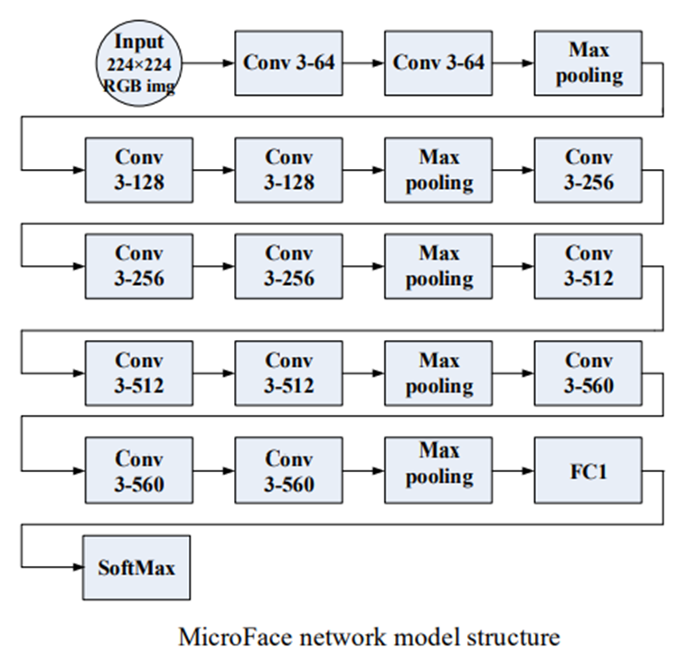
Face recognition based on improved VGGNET convolutional neural network
Model : MicroFace (VGG-16 Based)
Dataset Used : CASIA WebFace
model
related work
future work
introduction
limitations
result
cnn layers
Contains 500000 images of 10575 people.
Coloured images with image size 224 X 224.
Group Members
MD. MUZAKKER HOSSAIN 18-37801-2
ZAHIN AWOSAF 18-37064-1
MD. SALMAN HOSSAN PROTTOY 18-36902-1
ABU SALEH MUHAMMOD ALVY 18-37487-1
Accuracy : 96.26%
Notes:
this paper enhances the deep learning algorithm VGGNet for image classification and proposes the MicroFace face recognition method.
while reducing the two fully connected layers, effectively reducing network parameters while maintaining image feature extraction ability to the greatest extent possible.
the number of parameters is reduced from 138M to 17M, effectively reducing the memory space and training time required to save the network parameters. The detailed structure of the improved algorithm (MicroFace) has been shown on slide:
The data base is for training and testing the MicroFace network is CASIA WebFace. Each image must be standardized and scaled to 224x224 pixels. the recognition rate of the improved algorithm is 96.26%

Slide 9
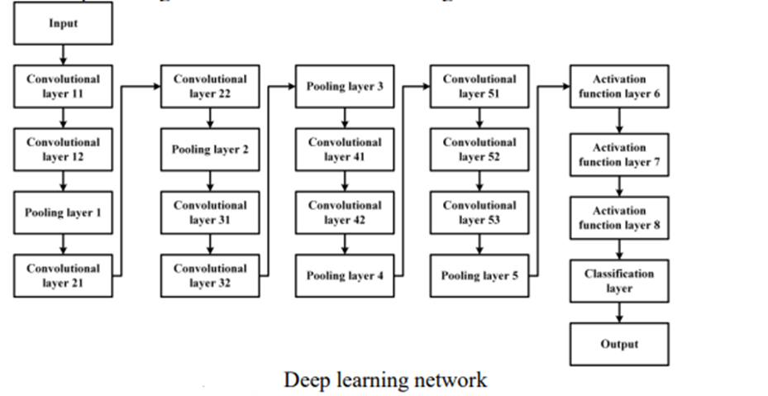
Face Recognition Algorithm Based On Convolutional Neural Network
Model : CNN
model
Dataset Used : CASIA WebFace
related work
future work
introduction
limitations
result
cnn layers
Group Members
MD. MUZAKKER HOSSAIN 18-37801-2
ZAHIN AWOSAF 18-37064-1
MD. SALMAN HOSSAN PROTTOY 18-36902-1
ABU SALEH MUHAMMOD ALVY 18-37487-1
Contains 494414 images of 10575 people.
100×100×1 grayscale image.
Accuracy : 98.78%
Notes:
a face recognition algorithm based on deep convolutional neural network is introduced in this paper. In order to improve the accuracy of face recognition, the design of 11 convolutional layers and 4 pooling layers. The network uses the standard face data set CASIA-WebFace for trainin.
The number of convolution kernels in module is increased from 560 to 600 to extract more abstract image features.
To train the network CASIA-WebFace standard face library was used. It contains 494414 face images of 10575 people. The pre-processing process of the image includes alignment and normalization of human faces and converting the image into 100×100×1 grayscale image.
The training process includes two processes, forward propagation and backward propagation. After testing, the accuracy of face recognition on the standard data set is improved to 98%.

Slide 10
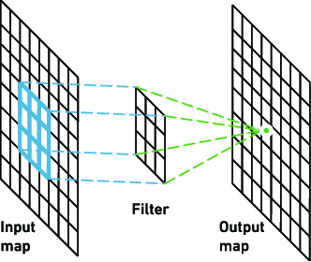
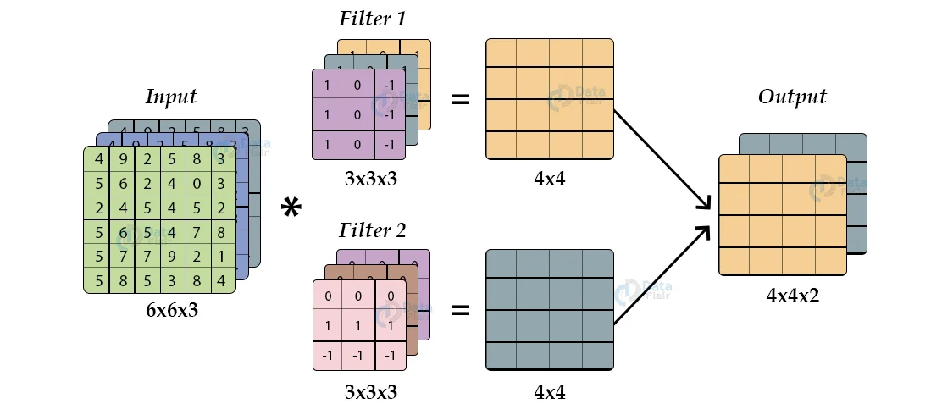
Output= (input- filter+1) × (input- filter +1)
Output= (input- filter+1) × (input- filter +1)
Convolutional layer
Output= (input- filter+1) × (input- filter +1)
model
related work
future work
introduction
limitations
cnn layers
result
Group Members
MD. MUZAKKER HOSSAIN 18-37801-2
ZAHIN AWOSAF 18-37064-1
MD. SALMAN HOSSAN PROTTOY 18-36902-1
ABU SALEH MUHAMMOD ALVY 18-37487-1
Example of Convolutional layer
Notes:
A Kernel or filter is an element in CNN that performs convolution around the image in the first part. The kernel moves to the right and shifts according to the stride value. Every time during convolution a matrix multiplication operation is performed.
After convolution, we obtain another image with a different height, width, and depth. We obtain more channels than just RGB but less width and height.
We slide each filter though out the image step by step, this step in the forward pass is called stride.
Here the input is of size 6×6×3 after applying a 3×3×2 kernel or filters you obtain a 4×4×2 output feature map so let us try to formulate this:
Input shape= 6×6×3
Filter shape= 3×3×2
Output= (input- filter+1) × (input- filter +1)
So that output will be
///////=(6-3+1)x (6-3+1)x(3-2+1)
= 4×4×2

Slide 11
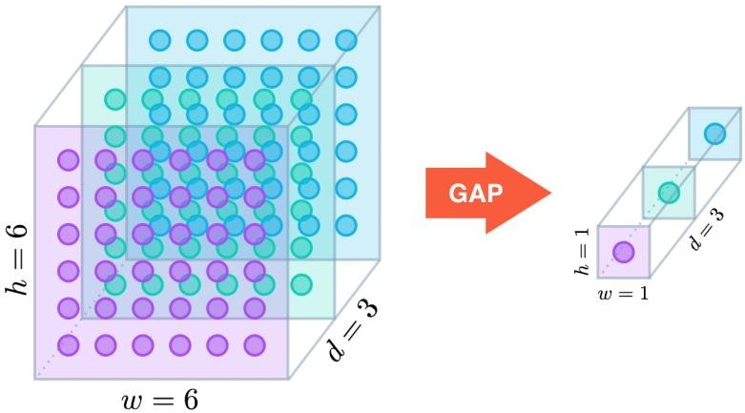
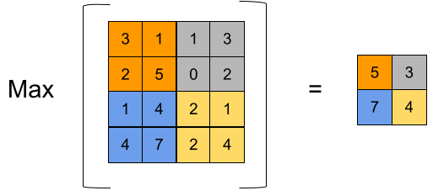
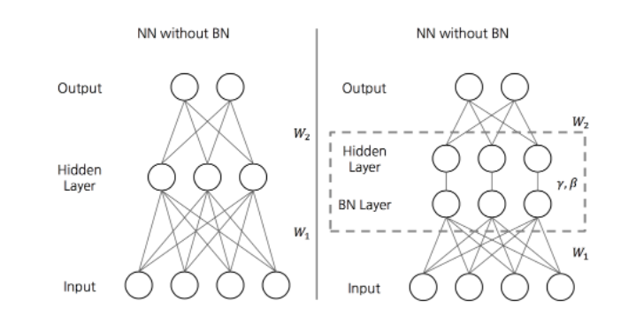
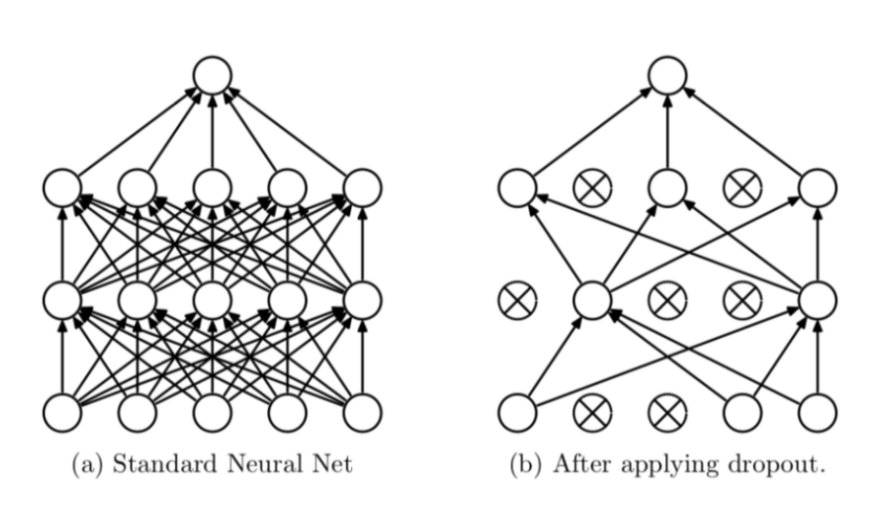
Global Average Pooling
Max Pooling
model
related work
future work
introduction
limitations
cnn layers
result
Group Members
MD. MUZAKKER HOSSAIN 18-37801-2
ZAHIN AWOSAF 18-37064-1
MD. SALMAN HOSSAN PROTTOY 18-36902-1
ABU SALEH MUHAMMOD ALVY 18-37487-1
Batch normalization
Dropout
Notes:
Global Average Pooling :
Global Average Pooling operation designed to replace full connected layers in CNN’s. Global Average Pooling block takes a tenson size (height x width x depth) and computes the average value of all values across the (height x width) matrix for each the channels.
Max pooling:
Max Pooling is a pooling operation that calculates the maximum value each path of each feature map. The result are pooling maps highlight the most feature in the patch.
Batch normalization :
Batch normalization is the most common form of normalization in deep learning . It scales in inputs to a layer to a common value for every mini-batch the training of deep network.
Dropout :
Dropout is effectively randomly removing some nodes of a neural network during each training step. The idea is that this will help the network become mor robust by not replying too heavily on any one node.

Slide 12
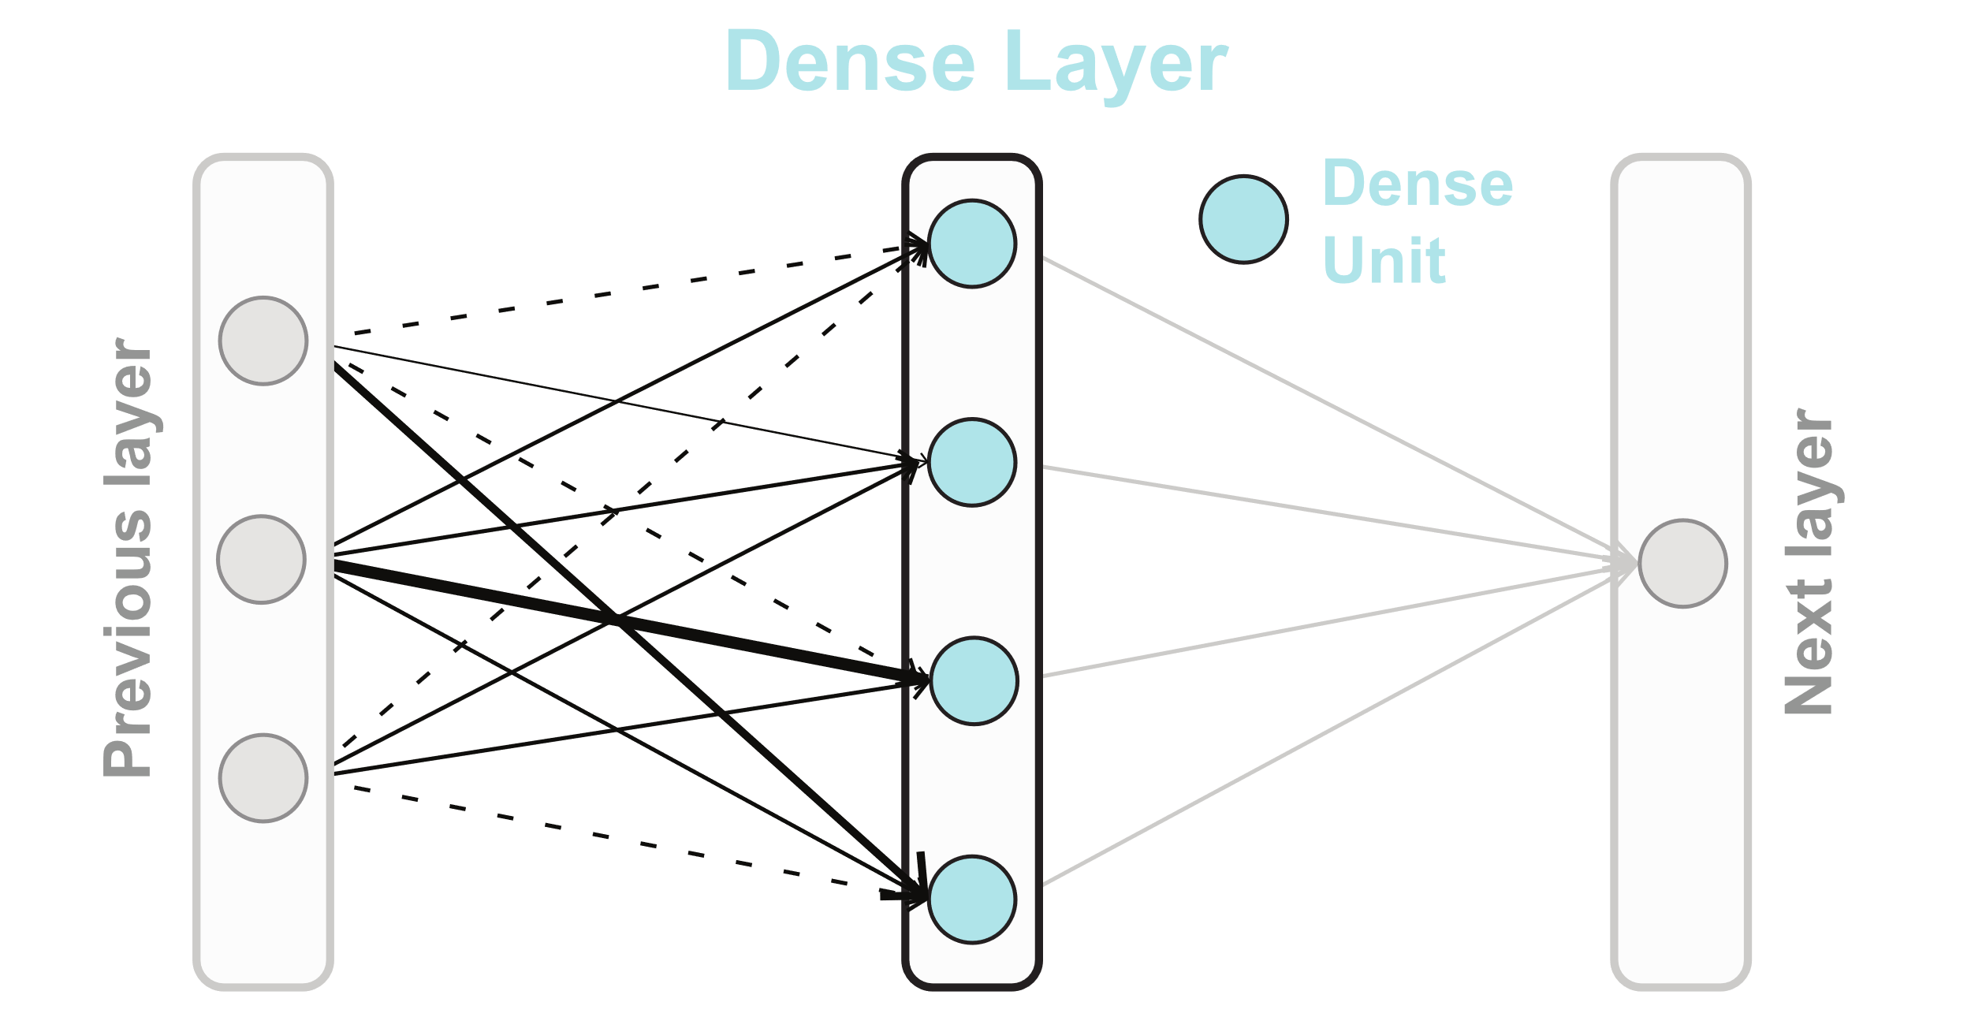
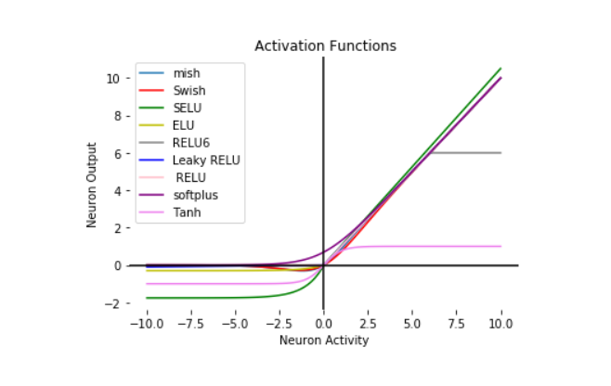
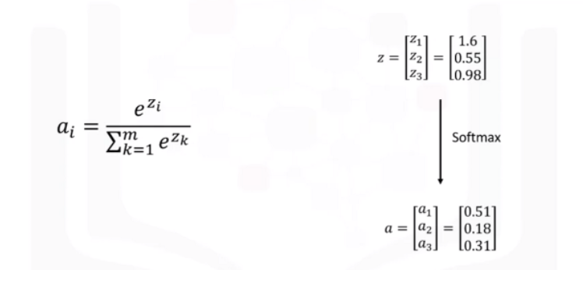
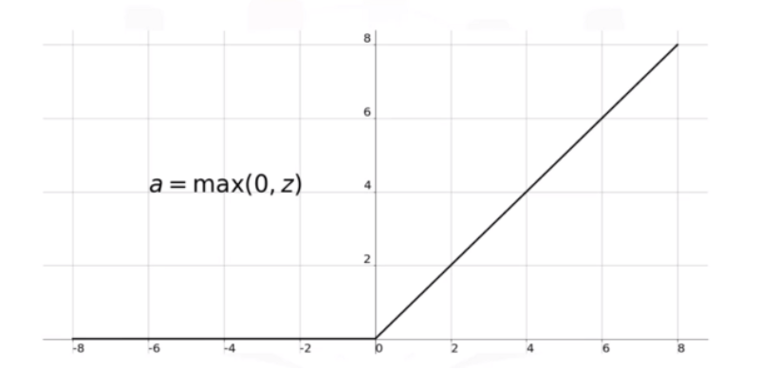
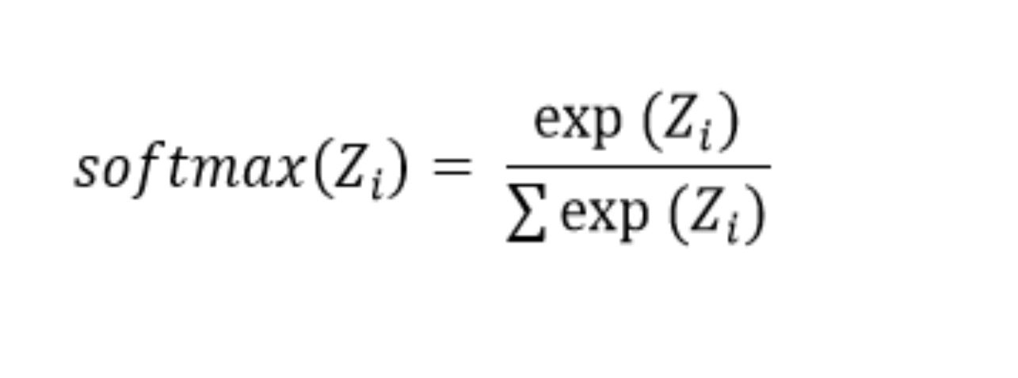
Dense Layer
Activation functions
model
related work
future work
introduction
limitations
cnn layers
result
Group Members
MD. MUZAKKER HOSSAIN 18-37801-2
ZAHIN AWOSAF 18-37064-1
MD. SALMAN HOSSAN PROTTOY 18-36902-1
ABU SALEH MUHAMMOD ALVY 18-37487-1
Softmax Function
ReLU Function
Notes:
Dense Layer
Dense Layer is simple layer of neurons in which each neuron receives input from all the neurons of previous layer, thus called as dense. Dense Layer is used to classify image based on output from convolutional layers.
Activation functions:
There are many popular activation functions used in deep neural network.
Softmax Function:
The softmax activation function is the generalized form of the sigmoid function for multiple dimensions. It is the mathematical function that converts the vector of numbers into the vector of the probabilities. The softmax activation function is commonly used as an activation function in the case of multi-class classification problems in machine learning. The output of the softmax is interpreted as the probability of getting each class.
The mathematical expression of softmax activation function is,
Here, the Z represents the values from the neurons of the output layer. The exponential acts as the non-linear function. Later these values are divided by the sum of exponential values in order to normalize and then convert them into probabilities.
Relu:
The rectified linear activation function for short is piecewise linear function that will output the input directly if it is positive , other wise it will output zero .

Slide 13
INPUT
CONV1_1
224X224X64
CONV1_2
224X224X64
MAXPOOL
224X224X3
MAXPOOL
112X112X64
CONV2_1
112X112X128
CONV2_2
112X112X128
56X56X128
CONV3_1
56X56X256
CONV3_2
56X56X256
CONV3_3
56X56X256
MAXPOOL
28X28X256
CONV4_1
28X28X512
CONV4_2
28X28X512
CONV4_3
28X28X512
MAXPOOL
14X14X512
CONV5_1
14X14X512
CONV5_2
14X14X512
CONV5_3
14X14X512
MAXPOOL
7X7X512
FC ReLU
1X1X4096
FC ReLU
1X1X4096
FC ReLU
1X1X1000
FC SOFTMAX (OUTPUT)
1X1X1000
related work
model
future work
introduction
limitations
result
cnn layers
Group Members
MD. MUZAKKER HOSSAIN 18-37801-2
ZAHIN AWOSAF 18-37064-1
MD. SALMAN HOSSAN PROTTOY 18-36902-1
ABU SALEH MUHAMMOD ALVY 18-37487-1
VGG16 ARCHITECTURE
Notes:
Thank you Hasebul hasan shihab. Hello everyone, I’m Ihsan Md. Al-Aqib. Here I’m going to present vgg16 ARCHITECTURE.
The number 16 in the name VGG refers to the fact that it is 16 layers deep neural network. This means VGG16 is a pretty extensive network and has a total of around 138 million parameters. VGG-16 configuration consists of 13 convolution network layers and 3 fully connected layers and stacked sequentially in 2 or 3 convolution network layers to build a module. Each module is followed by a maximum pool. It has three fully connected layers at the end of the structure, and the SoftMax layer outputs the identification class.
You can load a pretrained version of the network trained on more than a million images from the ImageNet database. The pretrained network can classify images into different categories.

Slide 14
INPUT
CONV1_1
224X224X64
CONV1_2
224X224X64
MAXPOOL
224X224X3
MAXPOOL
112X112X64
CONV2_1
112X112X128
CONV2_2
112X112X128
56X56X128
CONV3_1
56X56X256
CONV3_2
56X56X256
CONV3_3
56X56X256
MAXPOOL
28X28X256
CONV4_1
28X28X512
CONV4_2
28X28X512
CONV4_3
28X28X512
MAXPOOL
14X14X512
CONV5_1
14X14X512
CONV5_2
14X14X512
CONV5_3
14X14X512
MAXPOOL
7X7X512
related work
model
future work
introduction
limitations
result
cnn layers
Group Members
MD. MUZAKKER HOSSAIN 18-37801-2
ZAHIN AWOSAF 18-37064-1
MD. SALMAN HOSSAN PROTTOY 18-36902-1
ABU SALEH MUHAMMOD ALVY 18-37487-1
VGG16 REMOVED FC LAYERS
Notes:
Here removing layers from vgg16. Fully connected layers of vgg16 has been removed.

Slide 15
DENSE ReLU
DROPOUT
DENSE_1 ReLU
NORM_1
512
512
NORM
512
512
256
256
DROPOUT_1
256
DENSE_2 ReLU
128
NORM_2
128
DROPOUT_2
128
SOFTMAX (OUTPUT)
43
GLOBAL AVGPOOL
INPUT
7X7X512
related work
model
future work
introduction
limitations
result
cnn layers
Group Members
MD. MUZAKKER HOSSAIN 18-37801-2
ZAHIN AWOSAF 18-37064-1
MD. SALMAN HOSSAN PROTTOY 18-36902-1
ABU SALEH MUHAMMOD ALVY 18-37487-1
DENSE LAYERS
Notes:
Here is our model, takes input 7X7 and 512 input channel shape then input goes to global avgpool after that the matrices pass through 3 times to dense layer which activate ReLU activation, normalization and dropout layer with different input channel. Finally, it comes to output layer and activate softmax activation.

Slide 16
DENSE ReLU
DROPOUT
DENSE_1 ReLU
NORM_1
512
512
NORM
512
512
256
256
DROPOUT_1
256
DENSE_2 ReLU
128
NORM_2
128
DROPOUT_2
128
SOFTMAX (OUTPUT)
43
GLOBAL AVGPOOL
INPUT
224X224X3
CONV1_1
224X224X64
CONV1_2
224X224X64
MAXPOOL
112X112X64
CONV2_1
112X112X128
CONV2_2
112X112X128
MAXPOOL
56X56X128
CONV3_1
56X56X256
CONV3_2
56X56X256
CONV3_3
56X56X256
MAXPOOL
28X28X256
CONV4_1
28X28X512
CONV4_2
28X28X512
CONV4_3
28X28X512
MAXPOOL
14X14X512
CONV5_1
14X14X512
CONV5_2
14X14X512
CONV5_3
14X14X512
MAXPOOL
7X7X512
related work
model
future work
introduction
limitations
result
cnn layers
Group Members
MD. MUZAKKER HOSSAIN 18-37801-2
ZAHIN AWOSAF 18-37064-1
MD. SALMAN HOSSAN PROTTOY 18-36902-1
ABU SALEH MUHAMMOD ALVY 18-37487-1
MODEL PREPARED
Notes:
Here concatenated our model with vgg16 pretrained model. Now you can see the shape of the joining point matched. That means there won’t be any error on joining.

Slide 17
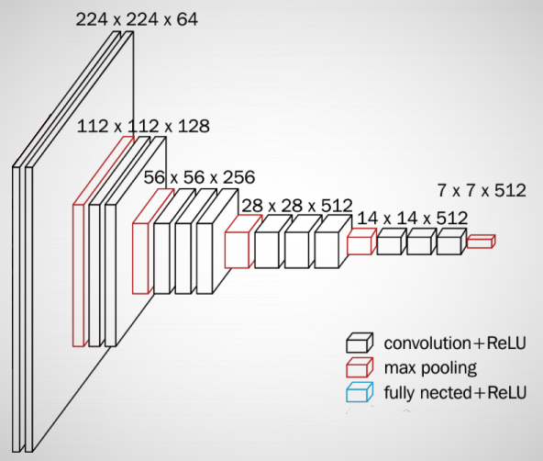
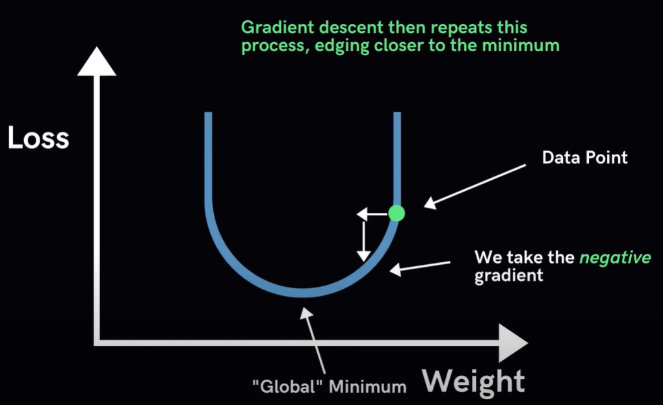
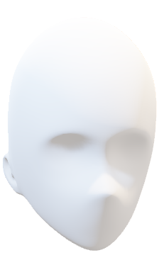
new_lr = lr * factor
VGG16 PRETRAINED
224x224x3
VGG16 pretrained model on ImageNet
Removed dense layer from vgg16
Combined model
INPUT
ImageNET
AVERAGE POOL
DENSE
BATCH NORMALIZATION
DROPOUT
DENSE
BATCH NORMALIZATION
DROPOUT
DENSE
BATCH NORMALIZATION
DROPOUT
OUTPUT
Frozen
related work
future work
introduction
limitations
model
result
cnn layers
Group Members
MD. MUZAKKER HOSSAIN 18-37801-2
ZAHIN AWOSAF 18-37064-1
MD. SALMAN HOSSAN PROTTOY 18-36902-1
ABU SALEH MUHAMMOD ALVY 18-37487-1
Factor 0.2
Learning rate= 1e-3
new_lr = lr * factor
Notes:
Here you can see it takes input first from the dataset and go through the vgg16 which already has trained value from imageNET database. After that the matrices value Loop through our model.
In this combined model we use transfer learning which learning rate starts at 1e-3, reduce learning rate by o.2 factor is specialty of this model. In that case vgg16 value has been frozen or not upgrading weights value, only upgrading value on loop area.
Now, Transfer learning
Iterative Algorithm that starts off at a random point on the loss function and travels down its slope in steps until it reaches the lowest point (minimum) of the function.
Algorithm works by (i)Calculate what a small change in each individual weight would do to the value loss function and (ii)Adjust each parameter based on its take a small step in the determined direction. Repeat steps until the value loss function is as low as possible.
Reduce learning function monitor the value loss and factor by which the learning rate will be reduced. click
This function also has a parameter called patience which count number of epochs with no improvement after which learning rate will be reduced. Another parameter called min_lr which is a lower bound on the learning rate.
Now my fellow teammate MD SAKIBUL ALAM UTCHAS will continue

Slide 18
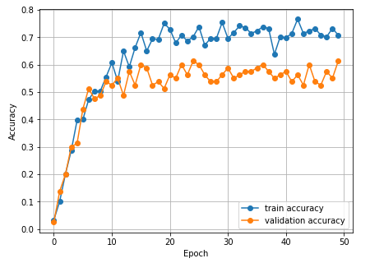
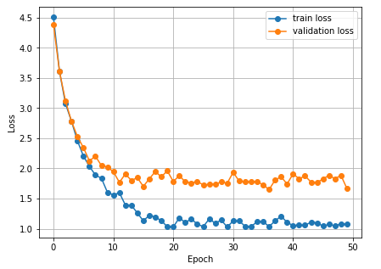
DATASET: 430 images belonging to 43 classes
Training: 344 images belonging to 43 classes.
Validation : 0.2% (86 images belonging to 43 classes)
ACCURACY: 61.125%
related work
model
future work
introduction
limitations
result
cnn layers
Group Members
MD. MUZAKKER HOSSAIN 18-37801-2
ZAHIN AWOSAF 18-37064-1
MD. SALMAN HOSSAN PROTTOY 18-36902-1
ABU SALEH MUHAMMOD ALVY 18-37487-1
Notes:
Thank you, Aqib. Assalamu Alaikum. I am MD SAKIBUL ALAM UTCHAS.
Now the question is how the model was trained and what the result was?
As we can see from the slide, to train the model, we created a custom dataset that contains 430 images of 43 people, and from that dataset, 0.8% images used for training and 0.2% images were used for validation. The model was trained up to 50 EPOC and we can see from the graph after training the validation accuracy was increasing gradually and the validation loss was decreasing. After the training, we got over 61% validation accuracy, which is a modest result because this is a fine-grained classification.

Slide 19
Deep learning algorithm | Dataset Name | Dataset Size | Accuracy
Siamese-VGG | LFW Dataset | 13000 facial images of 1680 peoples. | 95.62 ± 0.42 %
MicroFace(VGG-16 Based) | CASIA WebFace | 500000 images of 10575 people | 96.26%
Custom VGG-16 (Using Transfer learning ) | Custom Made dataset | 430 images of 43 people | 61.125%
related work
model
future work
introduction
limitations
result
cnn layers
Group Members
MD. MUZAKKER HOSSAIN 18-37801-2
ZAHIN AWOSAF 18-37064-1
MD. SALMAN HOSSAN PROTTOY 18-36902-1
ABU SALEH MUHAMMOD ALVY 18-37487-1
Notes:
From the table we can see that the dataset we created was very small and complex compared to another dataset. We create that dataset to represent real world scenario and the pictures of that dataset taken from different angels. Because of that the accuracy of this model was low compared other model and this reason make the model more superior than others.

Slide 20
The accuracy is modest, despite the use of fine-grained classification.
It is necessary to ensure that the face is visible.
Small dataset
related work
model
future work
limitations
introduction
result
cnn layers
Group Members
MD. MUZAKKER HOSSAIN 18-37801-2
ZAHIN AWOSAF 18-37064-1
MD. SALMAN HOSSAN PROTTOY 18-36902-1
ABU SALEH MUHAMMOD ALVY 18-37487-1
Notes:
There are also some limitations to our project. To ensure face recognition works perfectly, it is necessary to ensure that the face is visible perfectly. Otherwise, the system fails to recognize the face. Another problem is that, since we are doing fine-grained classification, so all the features extracted from the picture are almost the same, and because of that, it is hard to identify the person. On the other hand, the accuracy will be much higher if we classify different species like cats, dogs, rats, etc. Also, the dataset we used was relatively small. So, by using large datasets, the overall accuracy can be increased.

Slide 21
Future Work
Detect and recognize face from real time video feed.
Check for eye blinks
Use large dataset for higher accuracy
related work
model
future work
introduction
limitations
result
cnn layers
Group Members
MD. MUZAKKER HOSSAIN 18-37801-2
ZAHIN AWOSAF 18-37064-1
MD. SALMAN HOSSAN PROTTOY 18-36902-1
ABU SALEH MUHAMMOD ALVY 18-37487-1
Notes:
We need to take attendance most of the places, and the system of taking attendance is manual, which consumes valuable time and effort. Our goal is to automate the attendance system using computer vision and deep learning using state-of-the-art technology. To make our system better in the future, we will work on a module which can recognize face from real-time video feed and also check for eye bilks to identify real human presence. It’s an added layer of security to prevent any attendance by showing a picture of a person. Science this a fine-grained classification, to improve the accuracy of the model we will work on larger dataset with more sample images of the same class to improve accuracy so that the system can be used more reliably. If we can build and use a system like that, then we can avoid the hassle of taking attendance and use this time for other important work. The system can also be used for identifying unauthorized people. For all those reasons, future research needs to be done in this field.

Slide 22
Thank You
related work
model
future work
introduction
THE END
limitations
result
cnn layers
Group Members
MD. MUZAKKER HOSSAIN 18-37801-2
ZAHIN AWOSAF 18-37064-1
MD. SALMAN HOSSAN PROTTOY 18-36902-1
ABU SALEH MUHAMMOD ALVY 18-37487-1
Notes:
That’s all from me. Thank you all for giving us the opportunity and time.

